Slide 1


Reaction/momentum wheel
Educational satellite program (ESP)
Esraa Mohamed – Gehad Essam – Islam Sami – Mohamed Hussein – Youhana Mikhaiel
Under the supervision of Eng. Ahmed Farrag

Slide 2
Outline
1- Introduction
2- Mission analysis
3- Mechanical Design
4- Integrating components and testing
5- Control
6- Final results
7- Questions

Slide 3
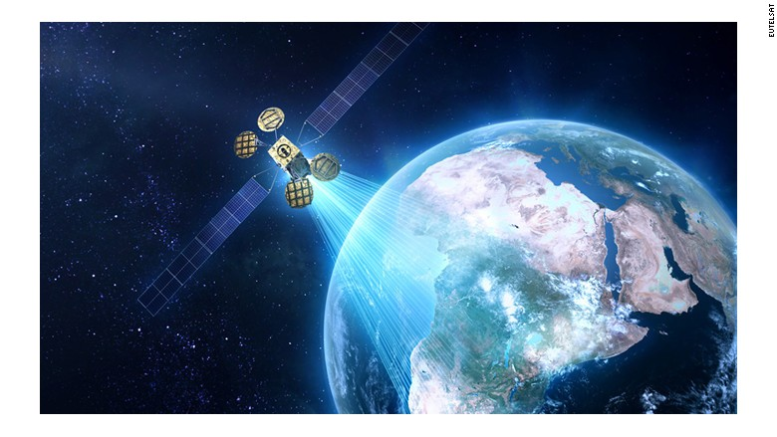
Introduction

Slide 4
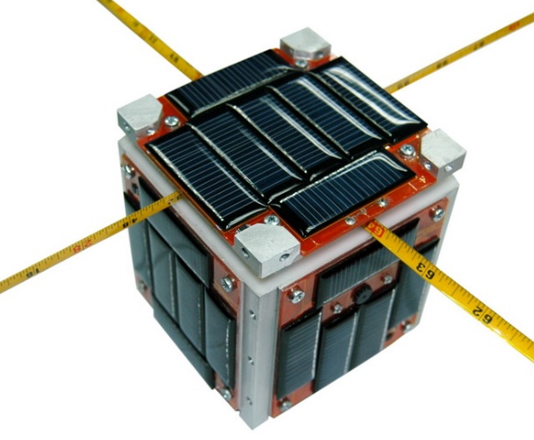

Command
data

Slide 5
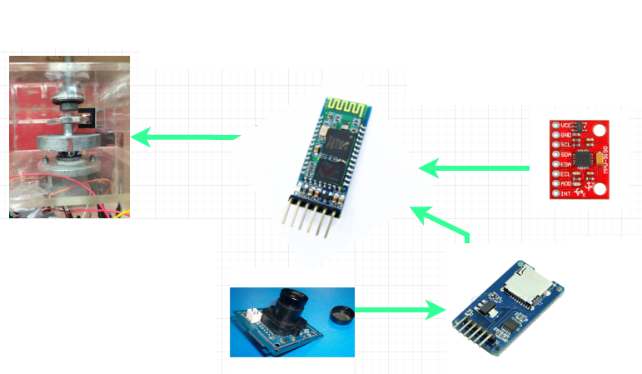
Subsystem instrumentation
Arduino Mega
Bluetooth module HC05 master-slave
DC Motor & motor shield
Camera OV & SD card
Gyro MPU 9150

Slide 6
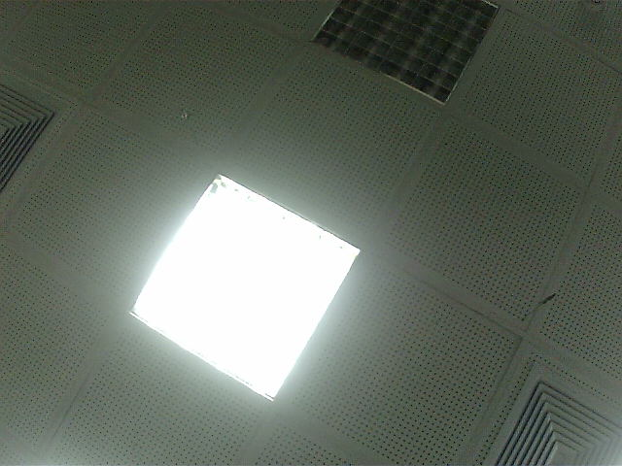
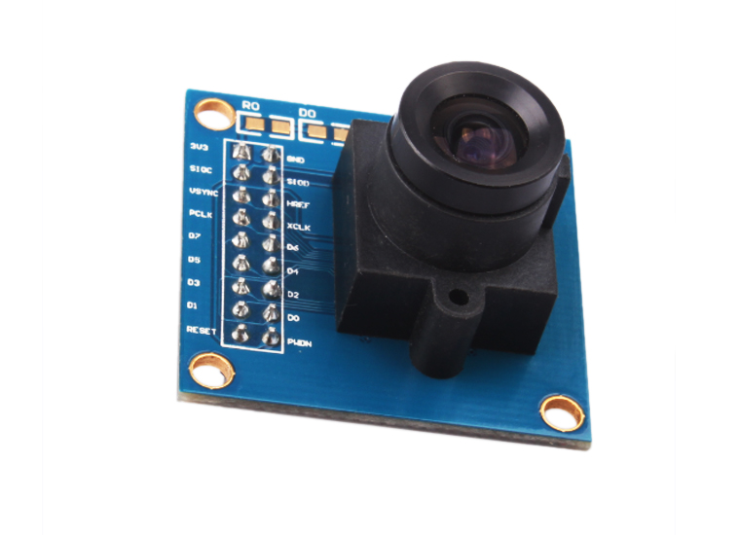
Sending imaging data

Slide 7
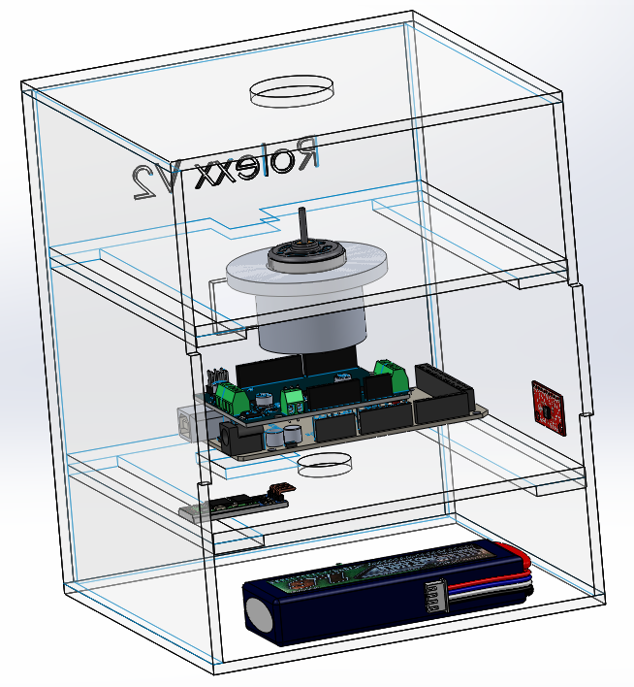
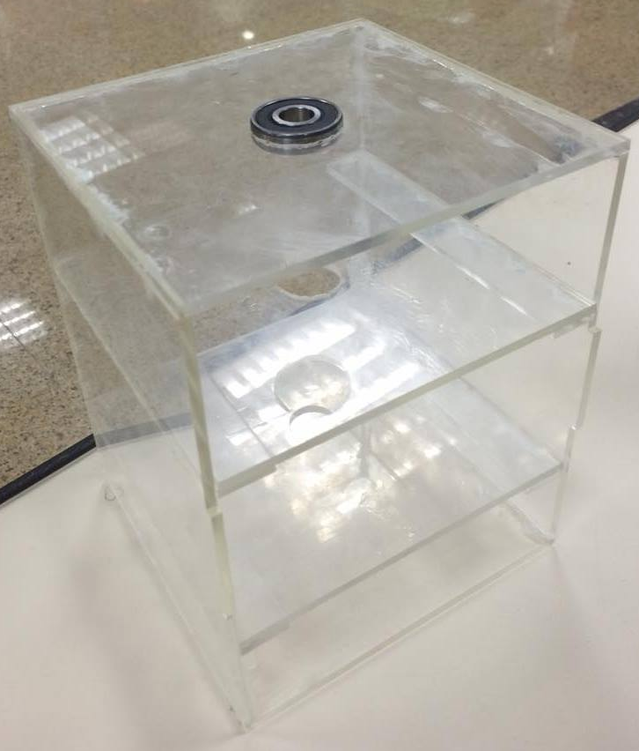
Mechanical design

Slide 8
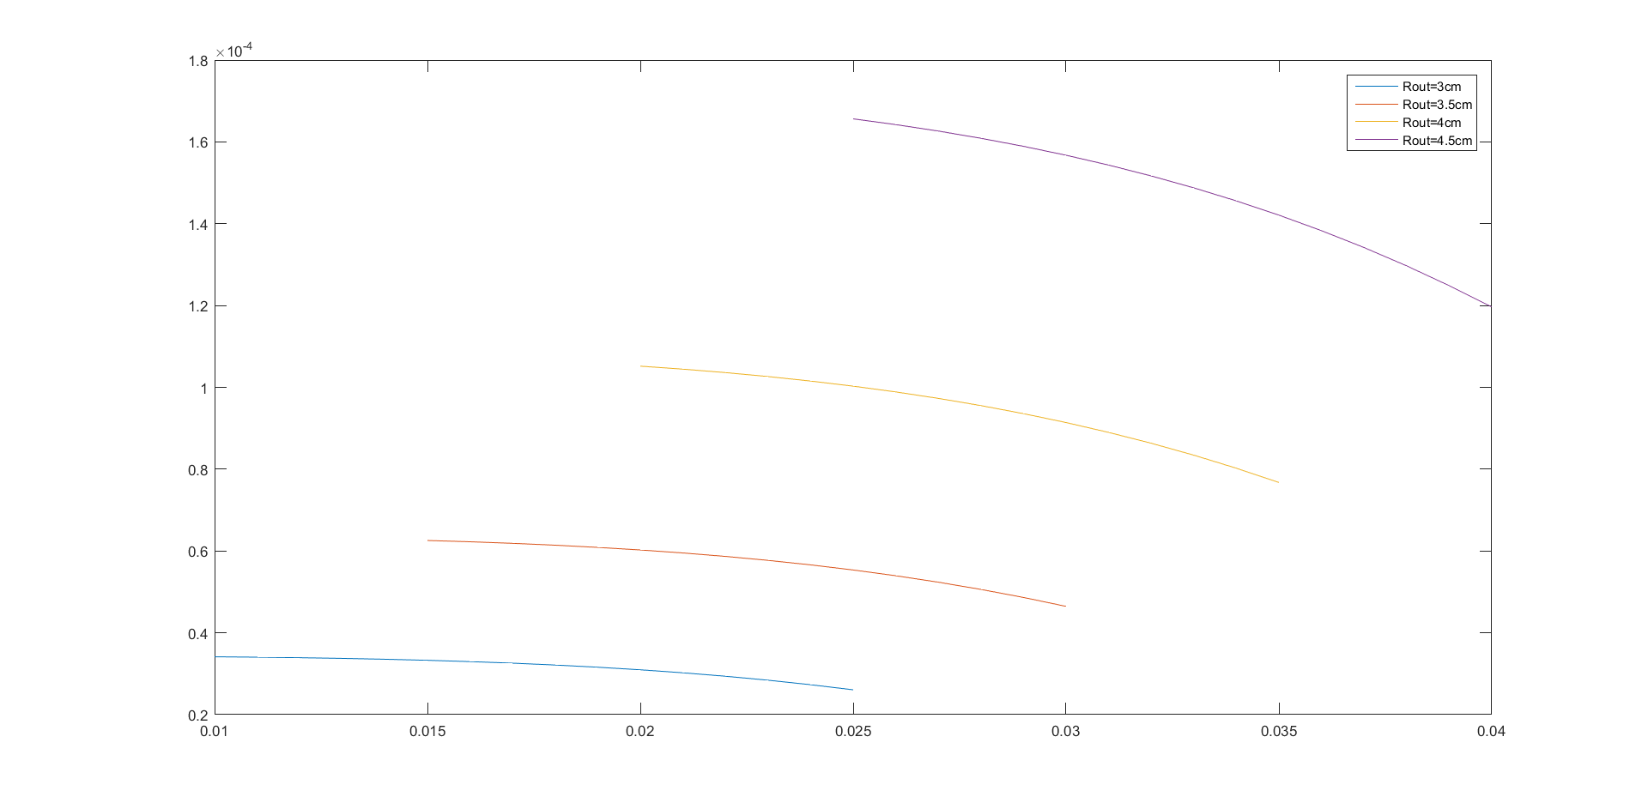
Wheel design
Aluminum wheel inertias

Slide 9
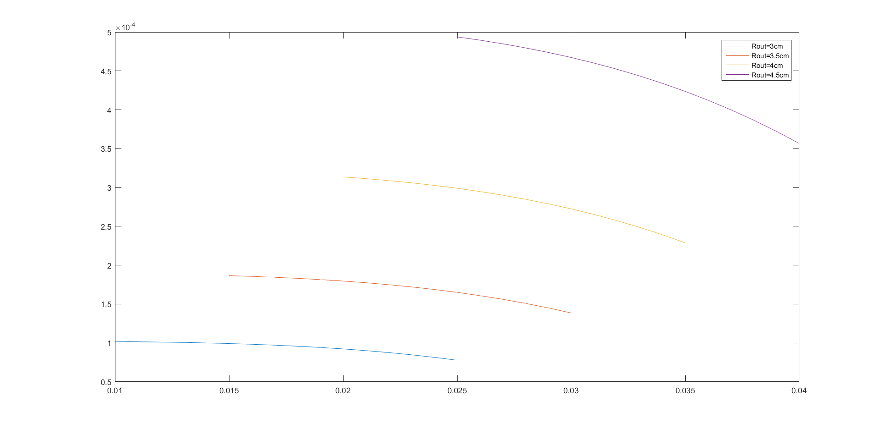
Wheel design
Steel wheel inertias

Slide 10
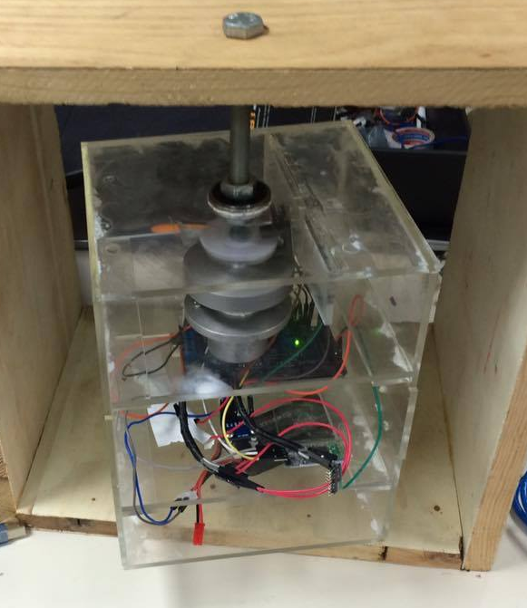
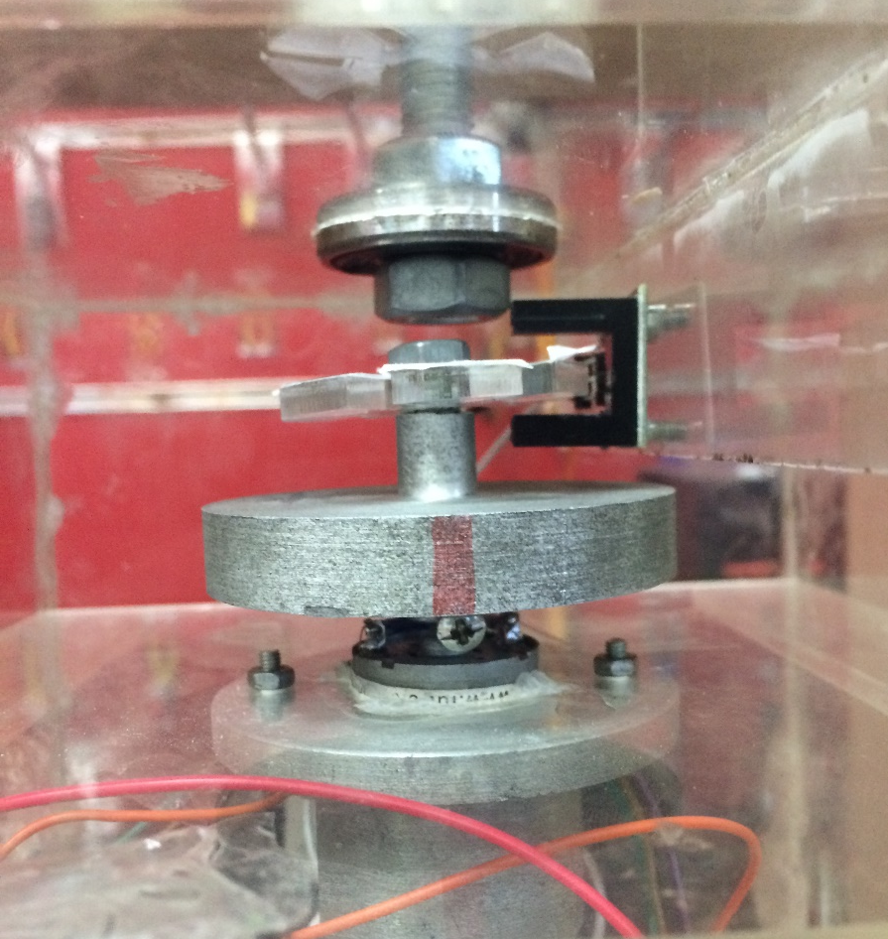
Design advantages

Slide 11
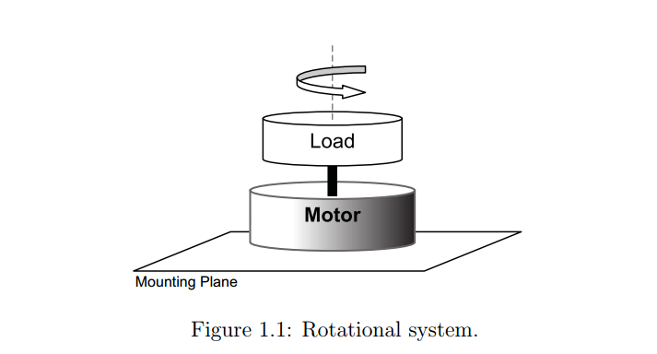
Theory

Slide 12
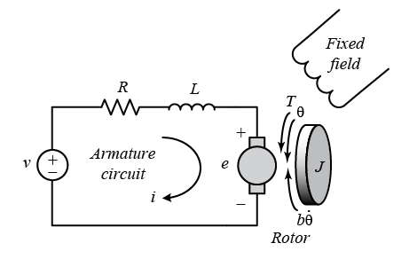

Mathematical model
$T(s)$ = $\left( Js^{2}+Ds\right) m\left(s\right)$
$R I\left(s\right)+L s I\left(s\right)+V\left(s\right)=E(s)$

Slide 13

Mathematical model
$\frac{θ_{m}(s)}{E_{a}(s)}=\frac{K_{t}/(R_{a}∗J_{m})}{s[s+\frac{1}{J_{m}\left(D_{m}+\frac{K_{t}∗K_{b}}{R_{a}}\right)}]}$
- Second order transfer function

Slide 14
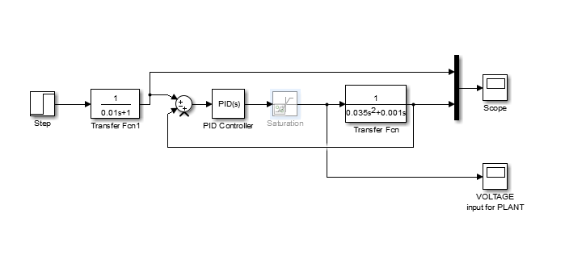
Simulink
Without motor’s parameters

Slide 15
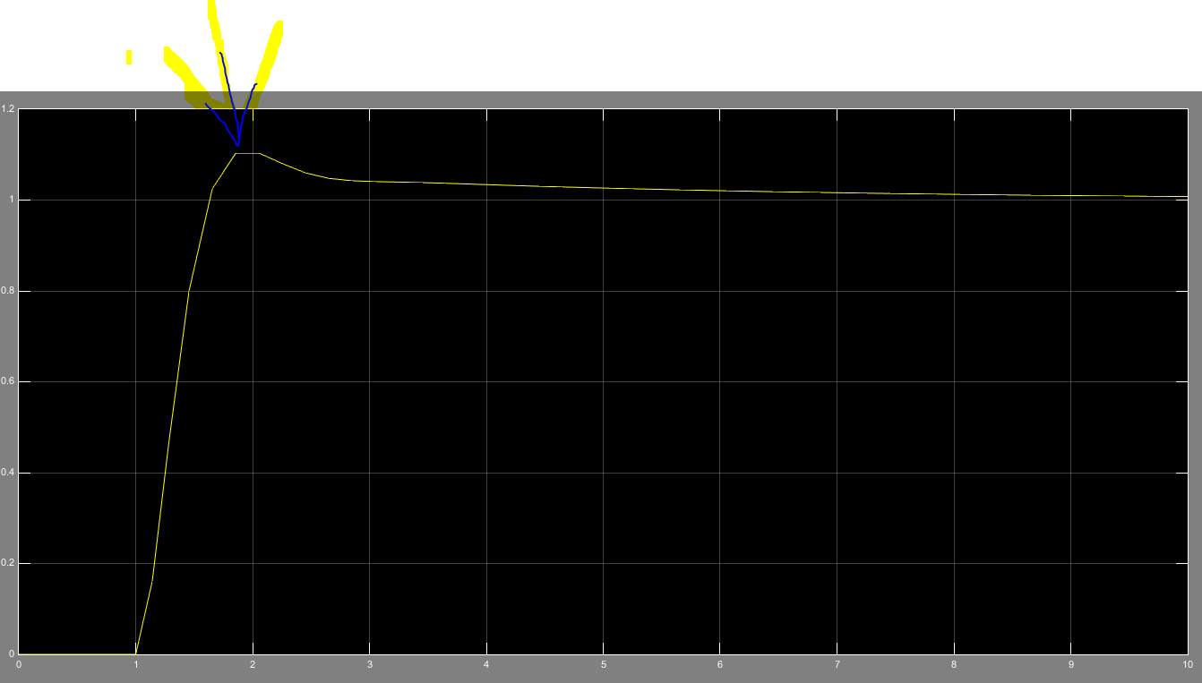
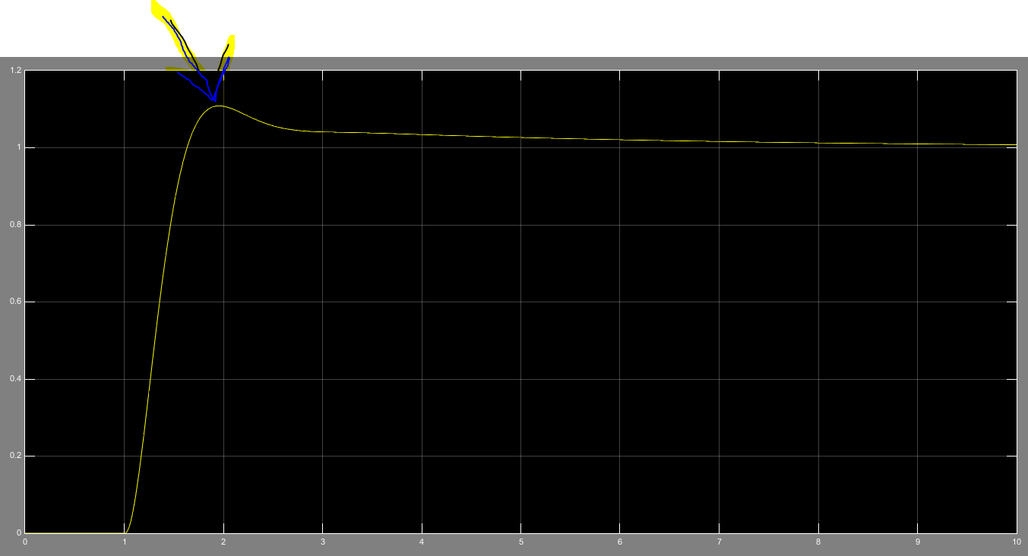
Simulink results
Without smoothing
With smoothing

Slide 16
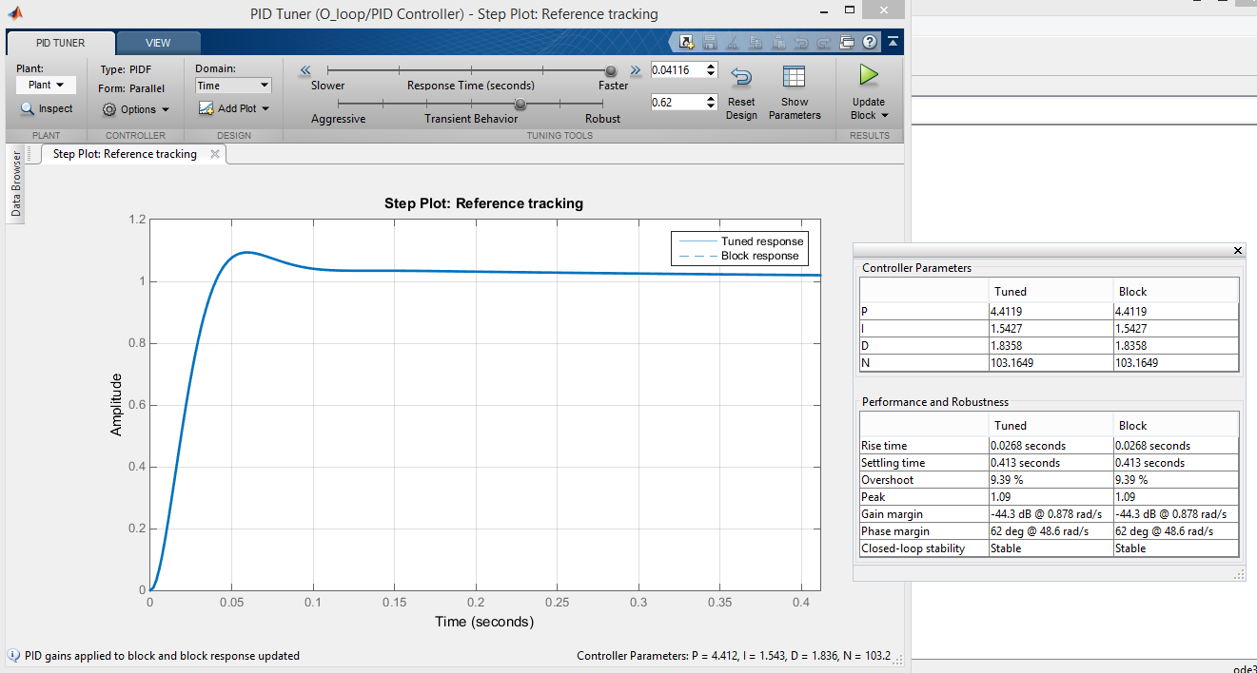
Control And PID tuning

Slide 17
Control And PID tuning

Slide 18
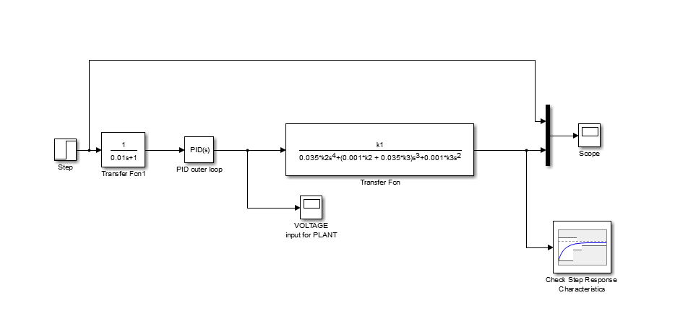
MATHEMATICAL AND SIMUILINK MODEL
Beginning of parameter estimation

Slide 19
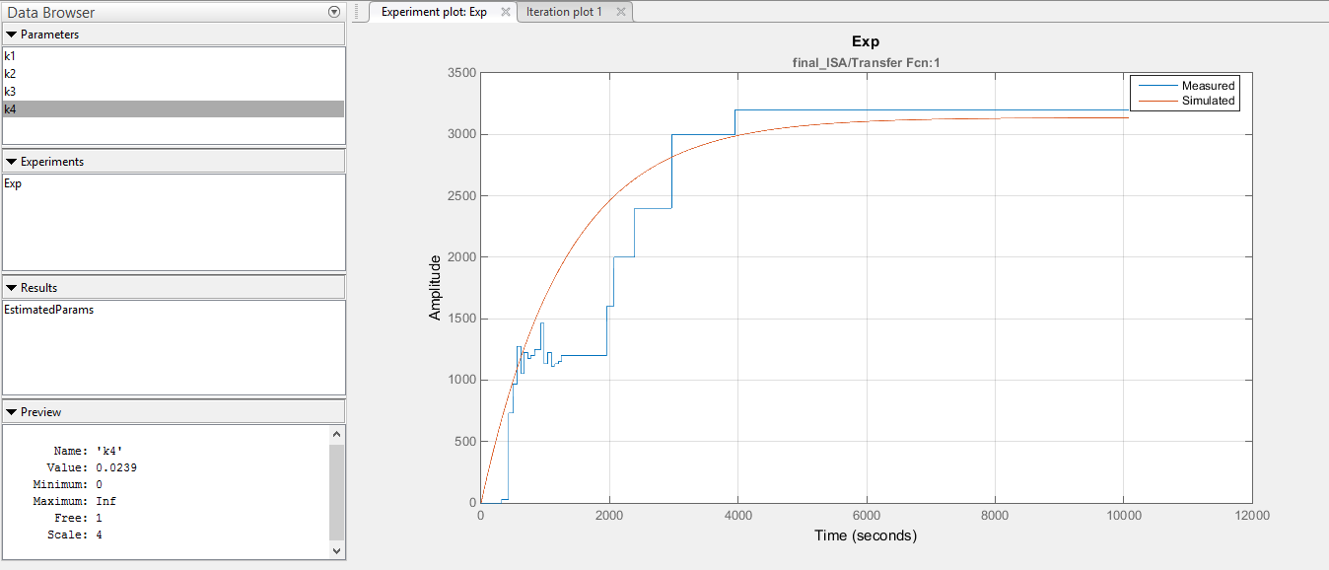
MATHEMATICAL AND SIMUILINK MODEL

Slide 20
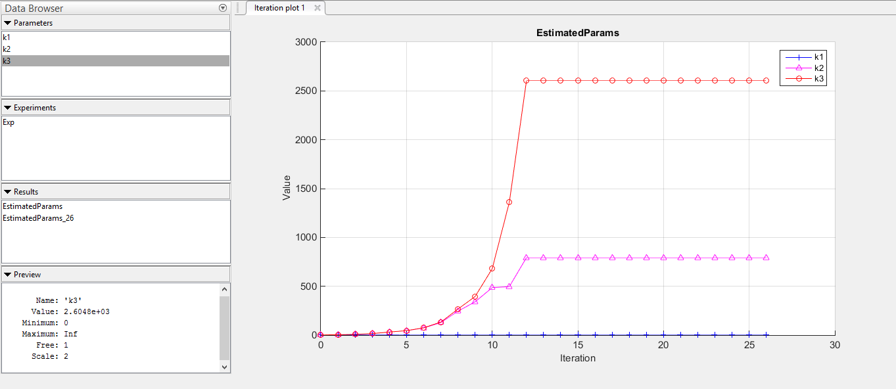
MATHEMATICAL AND SIMUILINK MODEL

Slide 21
Future Work
2D / 3D
Raspberry Pi (WiFi - Module)
Solar panels
Parameter Estimation
Validation By System Optimization

Slide 22
Questions?

Slide 23
Thank you

